Slide 1

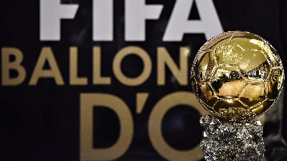
Data science project
By Matan Bar Eliyahu & Daniel Gelfand
GitHub link

Slide 2
Research question
What are the characteristics of the Ballon D'or winner and can it be predicted who will win?
Explanation of the competition

Slide 3
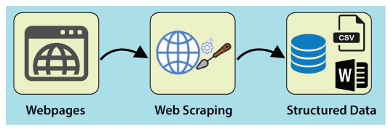
First step – data acquisition

Slide 4
Data sources
Scraping and crawling from:
Wikipedia
Fbref.com

Slide 5
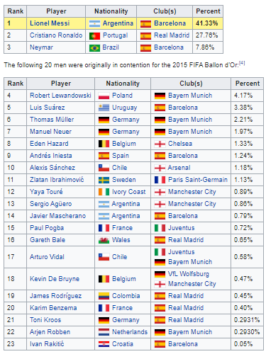
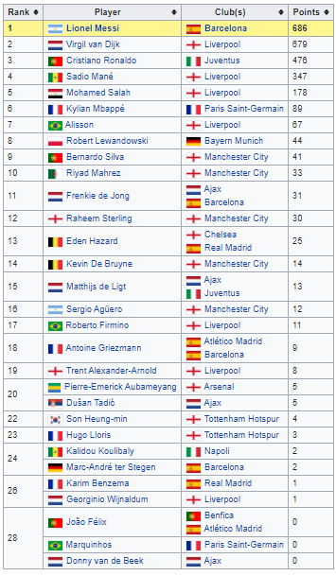
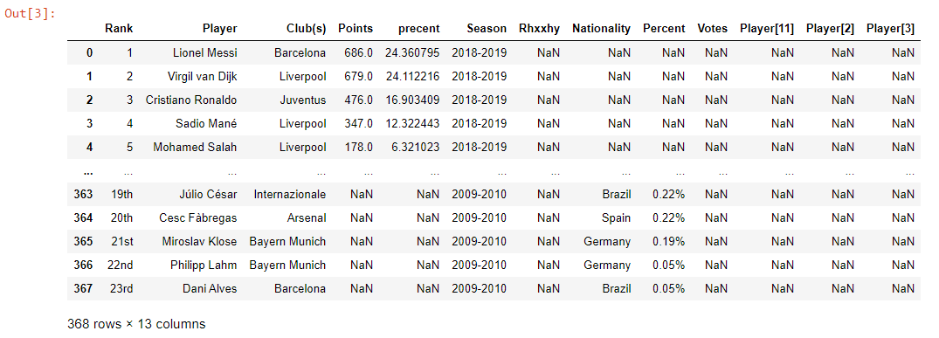
Scraping from Wikipedia
We used a built function from pandas library that reading htmal tables by the command “pd.read_html”.

Slide 6
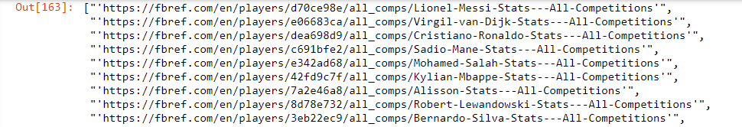
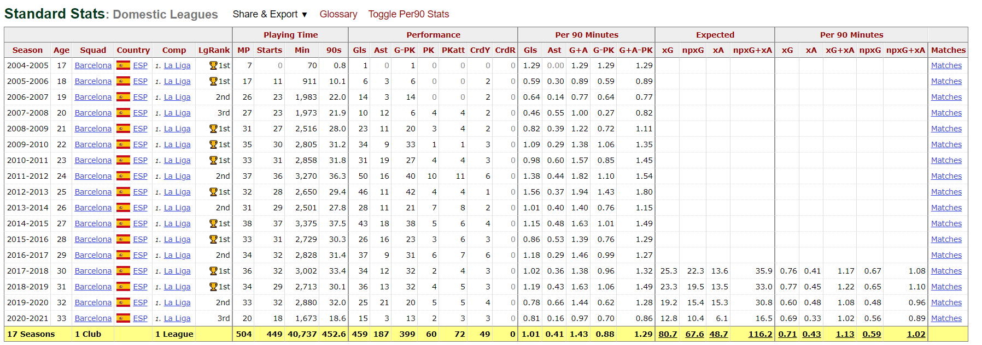
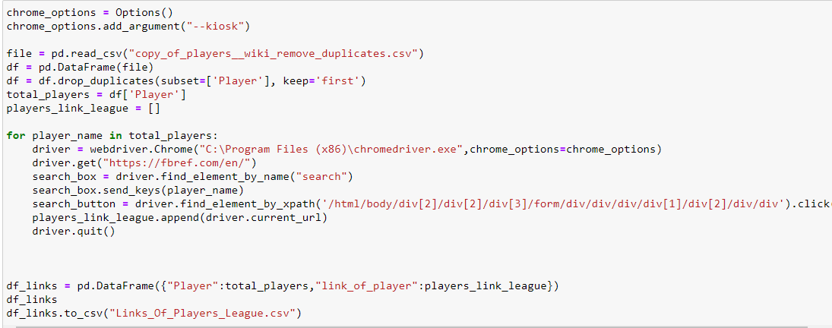
Scraping from Fbref
First, with copy of player list that we scrap from Wikipedia, we built BOT that use selenium library to copy link of each player in 'Fbref' site. → VIDEO
secondly we use built a function that use BeautifulSoup library to craw information about each player.

Slide 7

Step two – data handling & EDA

Slide 8
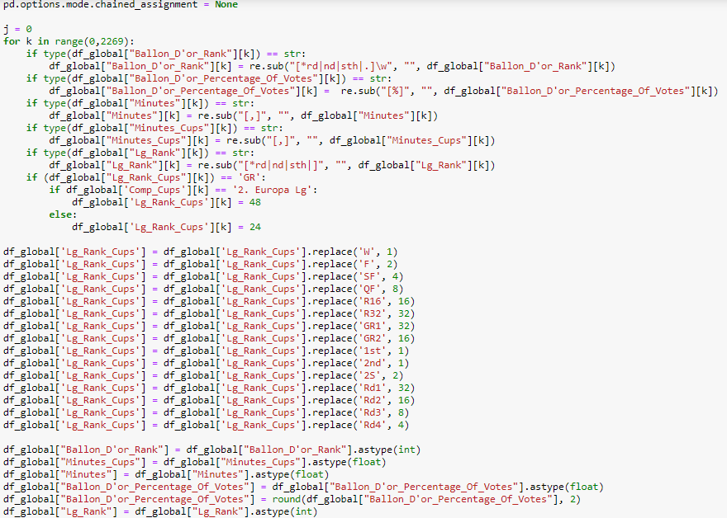
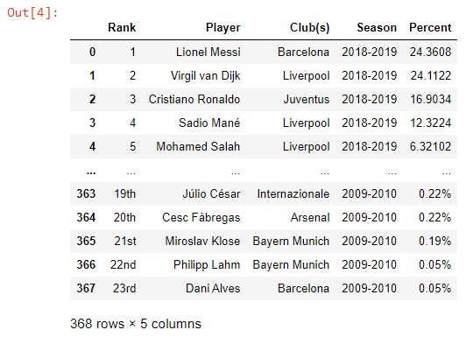
Data Handling and EDA
During data processing we encountered a number of difficulties: - Addressing deficiencies and various tables from Wikipedia (some years have different ‘Table’). - We Converted the Points/Percentage of Players to one standard variable. - ‘Casting’ strings variables to int variables. - Delete rows with missing values.

Slide 9
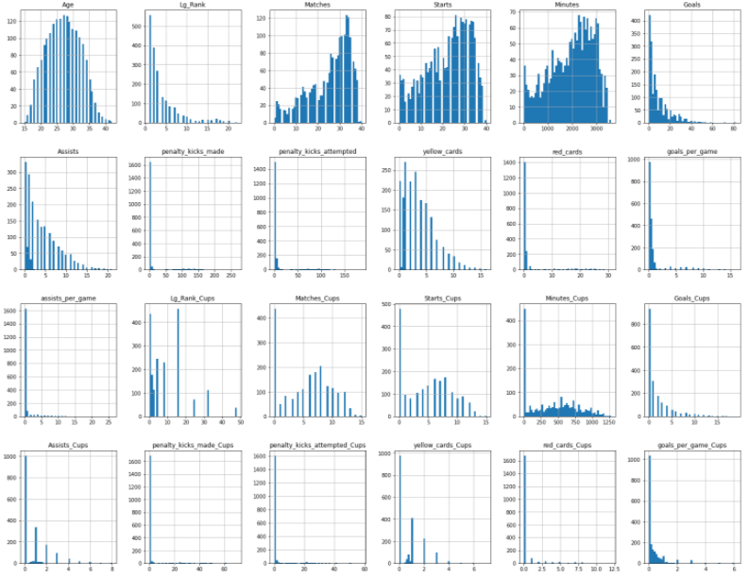

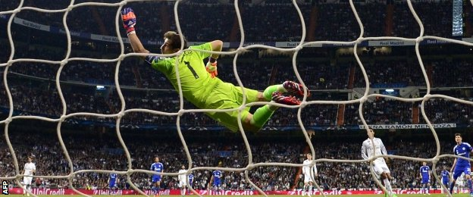
EDA- outliers
Handling outliers by using visualization plots: - in fact the most outliers in our data was the goalkeepers, because they have different columns than other player positions. (*penalty_kicks_made*) - Remove players that played under 15 games per session.
Note: A goalkeeper has never won Ballon D’or.

Slide 10

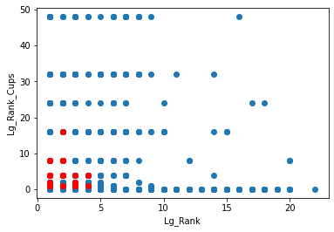
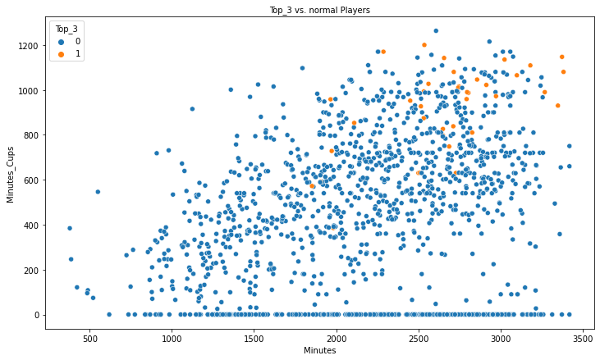
Visualization – Top 3
In this scatter plot we can see the connection between the top 3 stat and win league/cups.
It can be absolutely seen that a player who reached the top 3 stat, finished 1-5 place in the league and 1-10 in cups.
In this scatter plot we can see that player who reached to top 3 stat played a lot of minuets in two categories that checked. (League,Cups)

Slide 11
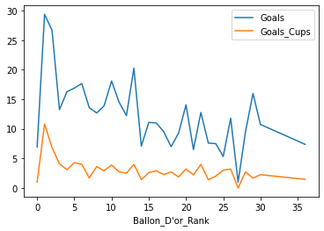
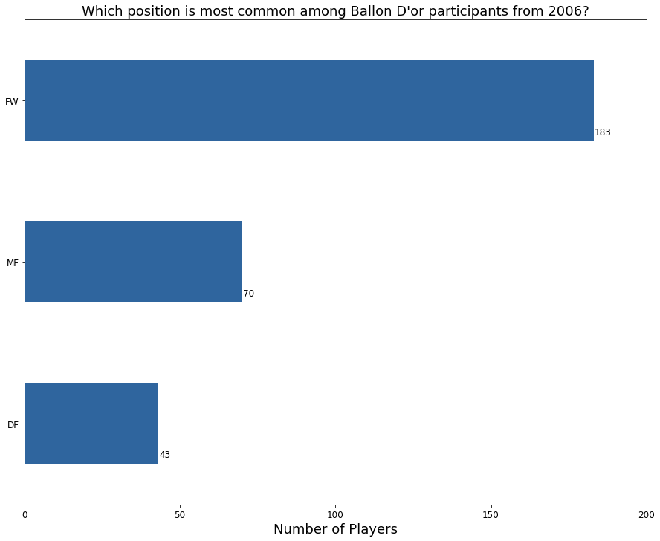
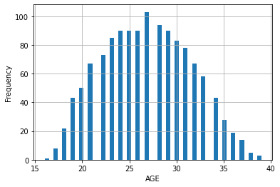
Visualization - player characteristics
In this plot we can see the connection between rank of Balloon D’or and goals per season in league/cups.
Who scored most goals in league/cups ranked in 1-5 place.
In this plot we can see the connection between participation in the competition and the position of player in game. (FW,MF,DF)
It can be absolutely seen that a player who on FW (forward) position have most participation in Balloon D’or.
In this plot we can see that the most common age range of the best players in the world is 23-29.

Slide 12
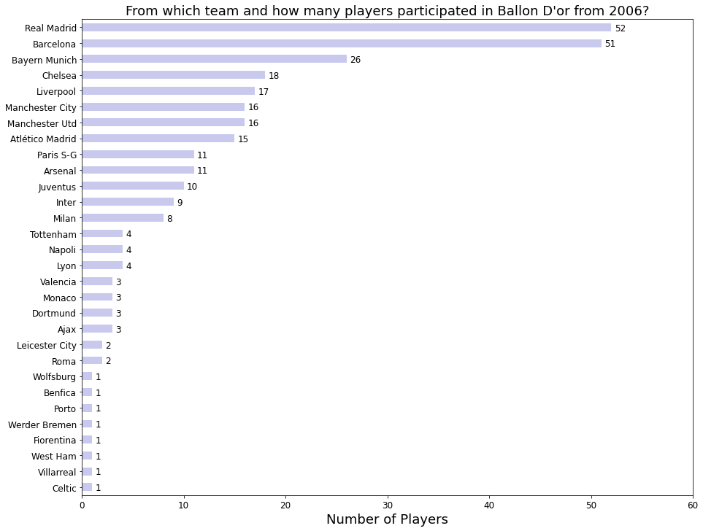
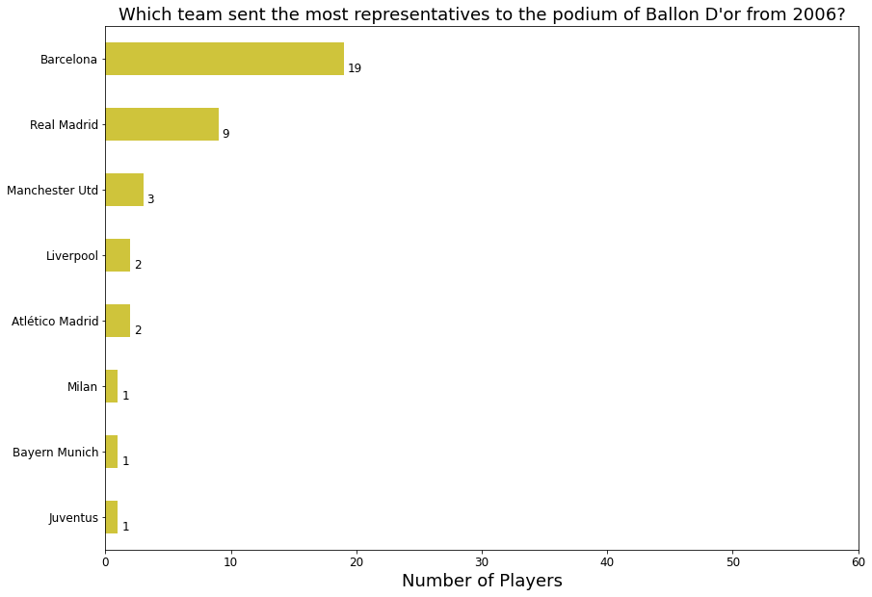

Visualization - Influence by groups
In that’s plots we can see the most teams that “sent” players to Balloon D’or.
We can see that the most team that have representatives In Balloon D’or is Real-Madrid, but the most top 3 players is from Barcelona.

Slide 13

Step three – machine learning

Slide 14
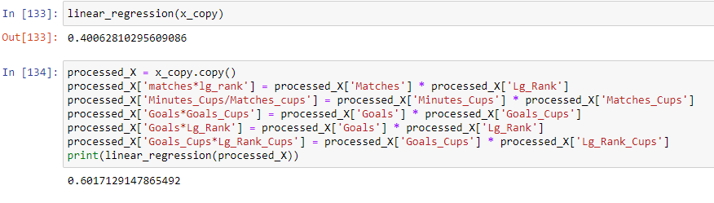
Linear regression
Using `sklearn` library for linear regression we were able to train a model that predicts the Ballon D’or
percentage of votes.
First we train a model by the relevant columns and we got a result of 0.406 After that, we performed a number of manipulations and reached an improvement of 0.2

Slide 15
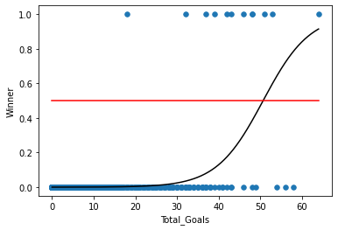
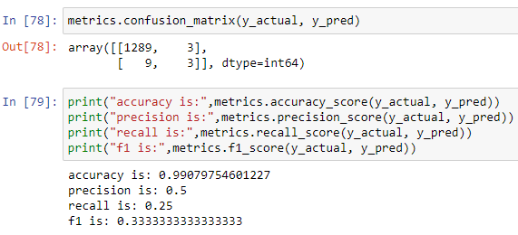

Logistic Regression
Using `sklearn` library for logistic regression we were able to train a model that predicts the winner of Ballon D’or by total goals per season.

Slide 16
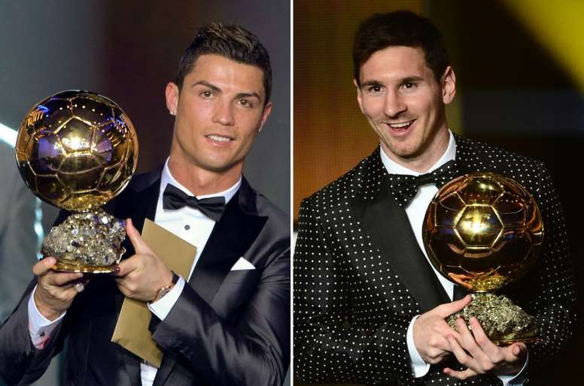
Research conclusions
The main conclusion that emerges from the research is that the more goals a player has scored for his team, There are more chances to win the Ballon d’or than others.
In addition, the research shows that usually the winners come from one of the biggest clubs in Europe.
Predicting the winner is not a simple matter, this is because the award was given based on the choices of journalists and coaches. However, we still managed to reach a model that gives us the result with an accuracy of 60% and in addition we can present the chances of each player winning according to the number of his goals.
Both players have the largest number of wins.
(5 each, until this moment)

